Slide 1






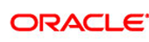


Cloud Computing
Addition to Networking

Slide 2
What is Cloud Computing?
There is no unique and standard definition out there
Cloud Computing is a general term used to describe a new class of network based computing that takes place over the Internet, basically a step on from Utility Computing.
In other words, this is a collection/group of integrated and networked hardware, software and Internet infrastructure (called a platform).
Using the Internet for communication and transport provides hardware, software and networking services to clients.
These platforms hide the complexity and details of the underlying infrastructure from users and applications by providing very simple graphical interface or API (Applications Programming Interface).

Slide 3
~Cont: What is Cloud Computing ?
In addition, the platform provides on demand services, that are always on, anywhere, anytime and any place.
Pay for use and as needed, elastic (scale up and down in capacity and functionalities).
The hardware and software services are available to the general public, enterprises, corporations and businesses markets.

Slide 4
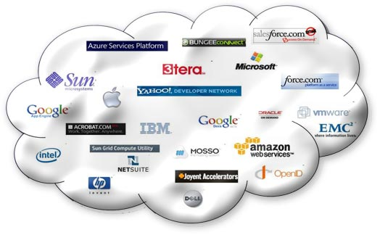
Commercial clouds

Slide 5
Cloud Models
Software as a Service (SaaS)
Platform as a Service (PasS)
Infrastructure as a Service (IaaS)
Cloud providers can offer all of these
“scalability” is a selling point – if you have an increased demand for something, the system can supply the demand within minutes if not seconds

Slide 6
For the average user
Google Gmail, Google Doc
Social Media (Facebook)
Media & Entertainment (Flickr, Soundcloud, YouTube)
Storage (Dropbox)
Amazon Web Services
Microsoft
Google
Check http://vimeo.com/16913034

Slide 7
Pluses to Cloud computing
Storage space
Portability
Cost savings
Collaboration
Businesses with unpredictable needs

Slide 8
Drawbacks
Security and Privacy
Who has access to your data? Government? Law enforcement? Commercial third parties?
Encryption – is it allowed by your cloud server?
See “Megauploads” case – 25 million GB of data locked up because of the behavior of a few people

Slide 9
Drawbacks (cont’d)
You are dependent on the reliability of the server
Proprietary formats or applications
Lack of support
Standards are still being developed
Requires an Internet connection (high speed)

Slide 10
For more reading
http://www.cloudcomputingtechie.com/what-is-cloud-computing-means/ (note it is a sales pitch)
http://www.infinitechusa.net/blog/2012/04/23/cloud-computing-disadvantages/

